Slide 1
Collective reviews
Peripheral nerve injury
R2 ชาติชาย/ อ.วิริยะ

Slide 2
Nerve injuries comprise 15–16% of the claims

Slide 3
Anesthesia-related nerve injury
Ulnar nerve 28 %
Brachial plexus 20 %
Lumbosacral nerve roots 16 %
Spinal cord 13 %
Nerve injury associated with anesthesia: a closed claims analysis.F. W. Cheney, K. B. Domino, R. A. Caplan, K. L. Posner. Anesthesiology. 1999 Apr; 90(4): 1062–1069.

Slide 4
Incidence of peripheral nerve injuries = 0.03%
Incidence of ulnar neuropathy = 0.037%
Incidence of lower extremities neuropathy in the lithotomy position 0.028%

Slide 5
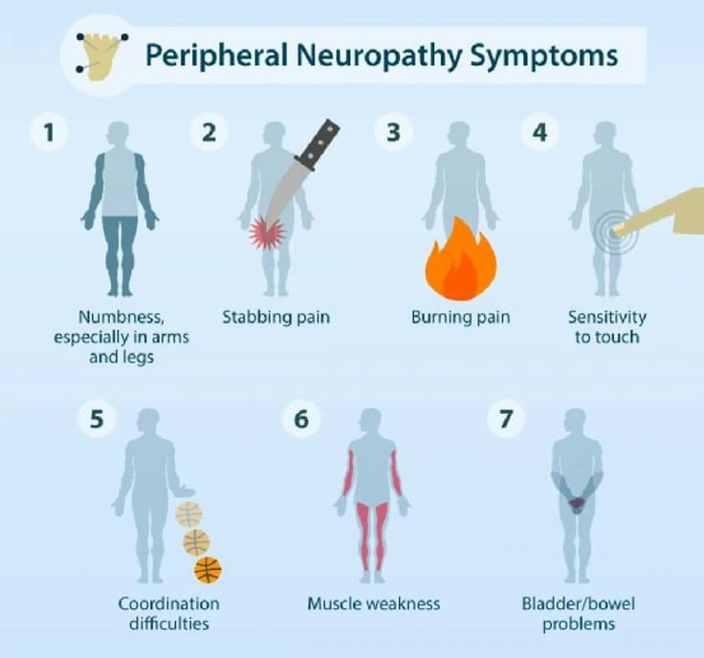
Perioperative peripheral neuropathy
Postoperative signs and symptoms related to peripheral nerve injury
Paresthesia
Muscle weakness
Tingling
Pain

Slide 6
Pathophysiology of peripheral nerve injury
Etiology
Stretch
Compression
Hypoperfusion
Direct trauma
Exposure to neurotoxic material
Combination
Notes:
impaired axoplasmic transport, axonal degeneration, Schwann cell damage, myelin destruction, segmental demyelination and complete Wallerian degeneration

Slide 7
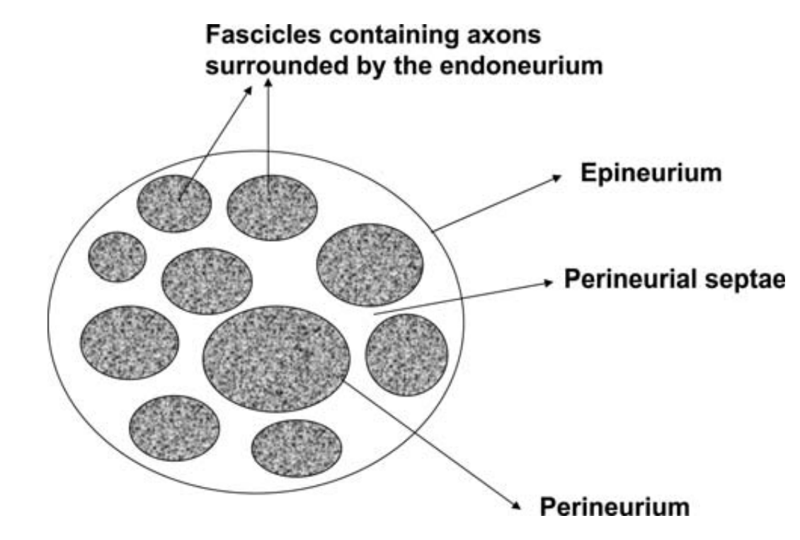
Nerve Anatomy

Slide 8
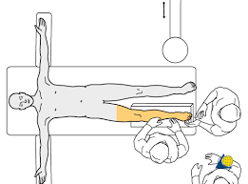
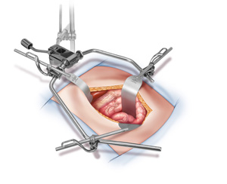
Stretch and compression
Poor padding and positioning of limbs
Use of tourniquets
Surgical retractors

Slide 9
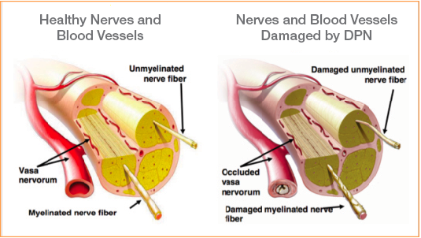
Hypoperfusion/Ischaemia
Tourniquets
Prolonged immobility
Hematoma surrounding a nerve
Local anesthetic agent
Physical disruption of the vasa nervorum, intraneural hemorrhage and/or endoneural edema

Slide 10
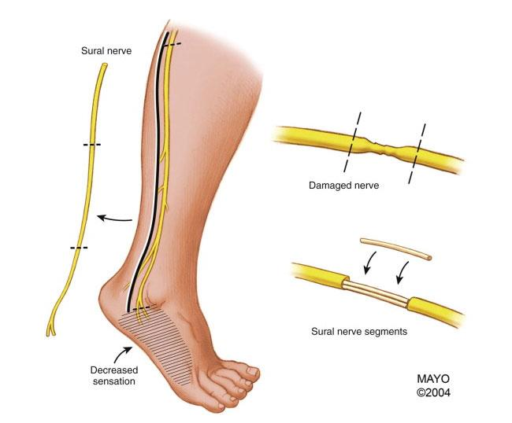
Direct trauma
Direct nerve damage
Surgery
Needle trauma secondary to a regional anesthesia

Slide 11
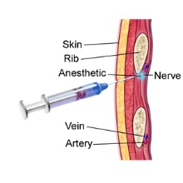
Exposure to neurotoxic material
Local anesthetics can produce cytotoxic axonal damage
If the solution is injected intrafascicularly
Highly concentrated solutions
Prolonged exposure predispose to nerve injury

Slide 12
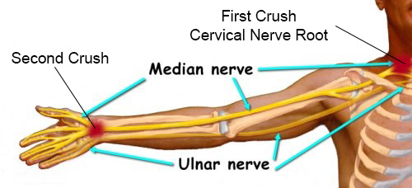
Double crush syndrome
Compressive lesion occurring along a nerve renders the nerve less tolerant of compression at the same or a second locus
Nerves with a preexisting injury or compression
Diabetes mellitus
Unstable joints
Subclinical insult resulting in a permanent nerve injury

Slide 13
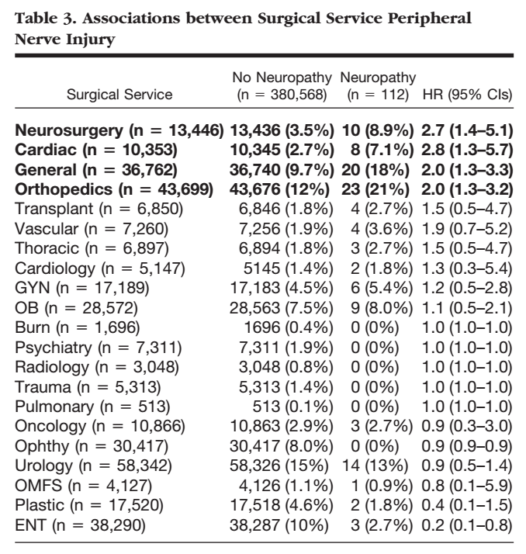
Predisposing factors
Surgical factors
Neurosurgery
Cardiac surgery
Gastrointestinal surgery
Orthopedic surgery
Perioperative Peripheral Nerve Injuries. A Retrospective Study of 380,680 Cases during a 10-year Period at a Single Institution. Marnie B. Welch, M.D.,* Chad M. Brummett, M.D.,† Terrence D. Welch, M.D.,‡ Kevin K. Tremper, Ph.D., M.D.,§ Amy M. Shanks, M.S., Pankaj Guglani, M.D.,† George A. Mashour, M.D., Ph.D.#

Slide 14
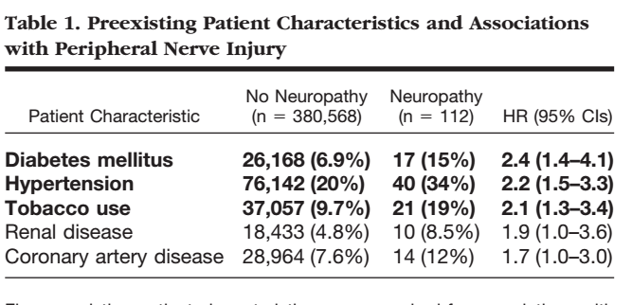
Predisposing factors
Patient factors
Hypertension
Diabetes mellitus
Smoking
Pre-existing peripheral neuropathies
Anatomical abnormalities
Perioperative Peripheral Nerve Injuries. A Retrospective Study of 380,680 Cases during a 10-year Period at a Single Institution. Marnie B. Welch, M.D.,* Chad M. Brummett, M.D.,† Terrence D. Welch, M.D.,‡ Kevin K. Tremper, Ph.D., M.D.,§ Amy M. Shanks, M.S., Pankaj Guglani, M.D.,† George A. Mashour, M.D., Ph.D.#

Slide 15
Advisory Recommendations for Preoperative History and Physical Assessment
Review Hx + PE
Body habitus -> obesity, low BMI
Preexisting neurologic symptoms
Diabetes mellitus
Peripheral vascular disease
Alcohol dependent
Arthritis
Sex (Male sex associate with ulnar neuropathy)

Slide 16
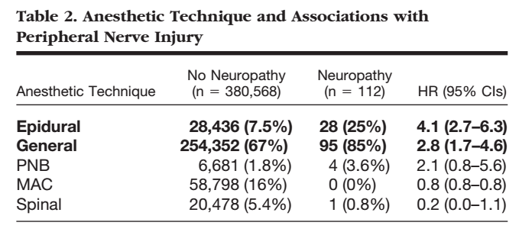
Predisposing factors
Anesthetic factors
General anesthesia
Epidural anesthesia
Perioperative Peripheral Nerve Injuries. A Retrospective Study of 380,680 Cases during a 10-year Period at a Single Institution. Marnie B. Welch, M.D.,* Chad M. Brummett, M.D.,† Terrence D. Welch, M.D.,‡ Kevin K. Tremper, Ph.D., M.D.,§ Amy M. Shanks, M.S., Pankaj Guglani, M.D.,† George A. Mashour, M.D., Ph.D.#

Slide 17
Predisposing factors
Perioperative factors
Hypovolemia
Dehydration
Hypotension
Hypoxia
Electrolyte disturbances
Hypothermia
Perioperative Peripheral Nerve Injuries. A Retrospective Study of 380,680 Cases during a 10-year Period at a Single Institution. Marnie B. Welch, M.D.,* Chad M. Brummett, M.D.,† Terrence D. Welch, M.D.,‡ Kevin K. Tremper, Ph.D., M.D.,§ Amy M. Shanks, M.S., Pankaj Guglani, M.D.,† George A. Mashour, M.D., Ph.D.#

Slide 18
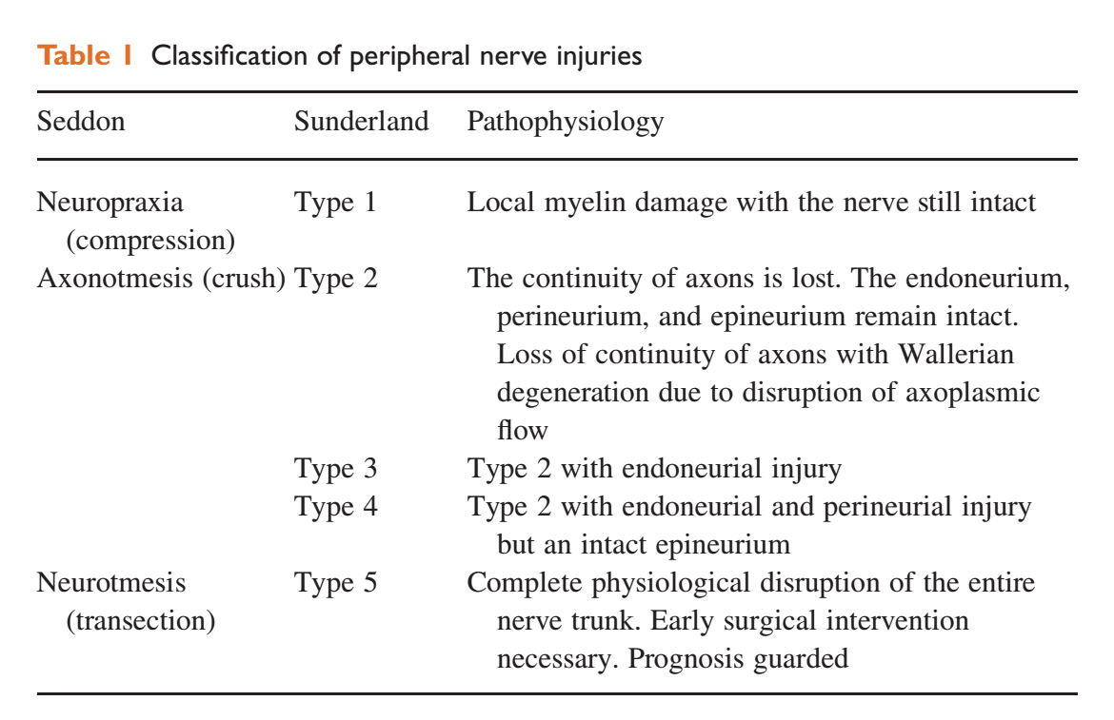
Classification of peripheral nerve injuries
Seddon HJ. Three types of nerve injury. Brain 1943; 66: 237–88

Slide 19
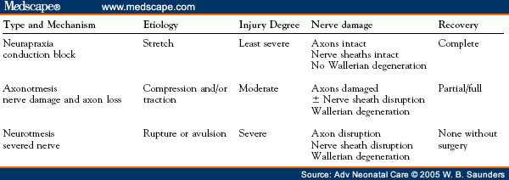

Slide 21
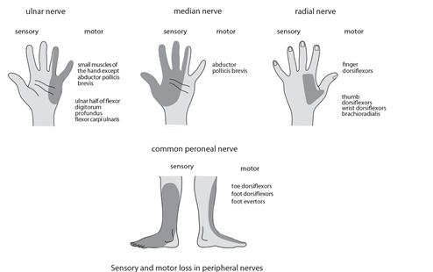
Clinical presentation of peripheral nerve injuries
Sensory deficit
Anesthesia
Paranesthesia
Hypo/Hyperaesthesia
Pain
Motor deficit
Paresis
Paralysis
Present at days to weeks following anesthesia

Slide 22
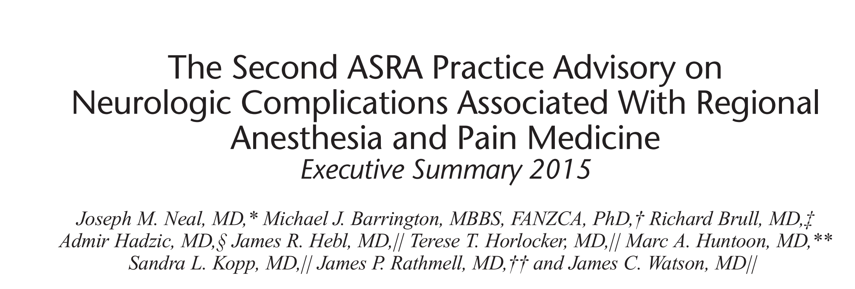
Postoperative neurologic symptoms (PONSs)
Common in the first days to month after peripheral nerve blockade
Incidence
0 - 2.2% at 3 months
0 - 0.8% at 6 months
0 - 0.2% at 1 year

Slide 23
Management
Document Symptoms
Systemic examination
Motor and sensory examination of all four limbs
Cranial nerves examination
Blood investigations
CBC,Electrolytes,Creatinine
Vitamin B 12
Thyroid hormone
ESR

Slide 24
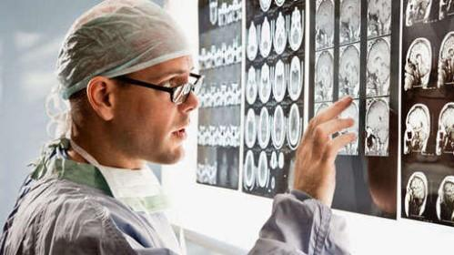
Management
Consult neurologist and neurophysiologist
Targeted serum plasma analysis
Nerve conduction studies
Electromyography
Magnetic resonance imaging (MRI)
Nerve biopsy

Slide 25
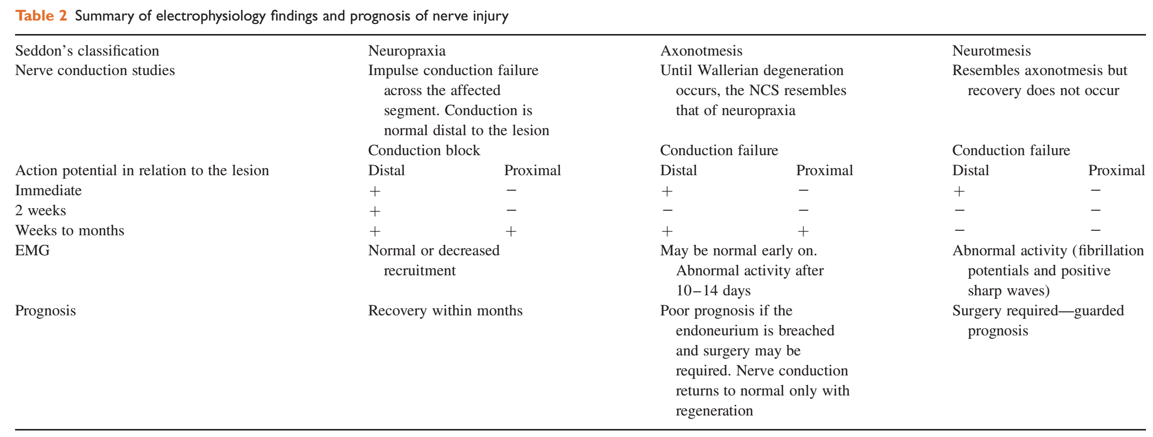

Slide 26
Management
Correct the underlying pathology
Haematoma -> urgent surgical decompression
Alleviate symptoms
Support, reassure and inform the patient

Slide 27
Peripheral nerve injuries related to position

Slide 28
Upper limb peripheral nerve injuries
Ulnar nerve injury (C7, C8–T1)
Brachial plexus injury (C5–T1)
Radial nerve injury (C5–T1)
Median nerve injury (C5–T1)
Axillary (C5, 6) and musculocutaneous nerve injury (C5–7)

Slide 29
Ulnar nerve injury (C7, C8–T1)
Incidence 0.037% , men>women
Most common perioperative nerve injury
Mechanism of injury
Direct pressure on the ulnar groove in the elbow and prolonged forearm flexion
Clinical presentation
Numbness along the little finger
Weakness of abduction, adduction of the fingers
Notes:
Men have less adipose tissue around the cubital tunnel and a more prominent coronoid tubercle compared with women, which may explain the 3:1 gender imbalance in the presentation of the condition

Slide 30
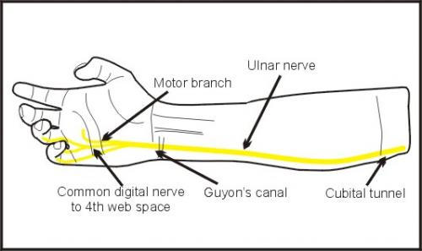
Ulnar nerve injury (C7, C8–T1)

Slide 32
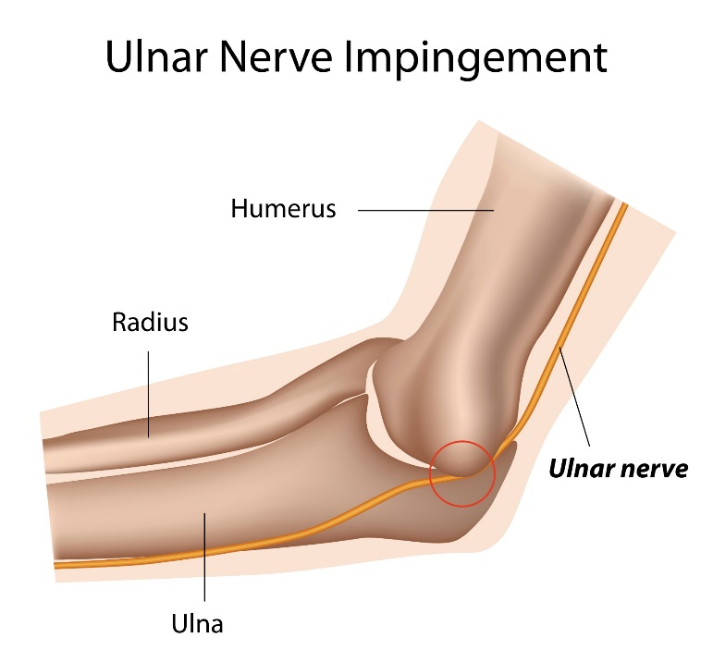
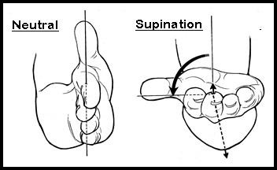
Supine Patient with Arm on an armboard
Position the upper extremity to decrease pressure on the post condylar groove of the humerus (ulnar groove)
Supine Patient with Arms Tucked at Side
Place the forearm in a neutral position
Flexion of the Elbow
Avoid ﬂexion of the elbow to decrease the risk of ulnar neuropathy
Notes:
full elbow extension with forearm pronation [44], avoidance of > 90° elbow flexion [45] and > 90° shoulder abduction

Slide 33
Brachial plexus injury (C5–T1)
Incidence 0.2–0.6%
Mechanism of injury
Compression, stretching ,direct injury
Extreme abduction of the arm (>90 degree)
Clinical presentation
C5–6 nerve roots -> Waiter’s Tip’ position
C8–T1 lesions -> claw hand , numbness in the ulnar distribution
Notes:
arm hangs by the side, medially rotated, and pronated

Slide 34
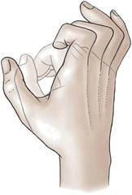
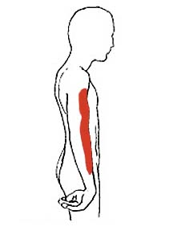
Brachial plexus injury (C5–T1)
Upper root (C5-6)
Lower root(C8-T1)
Erb’s palsy
Waiter ‘s tip deformity
Klumpke's palsy

Slide 35
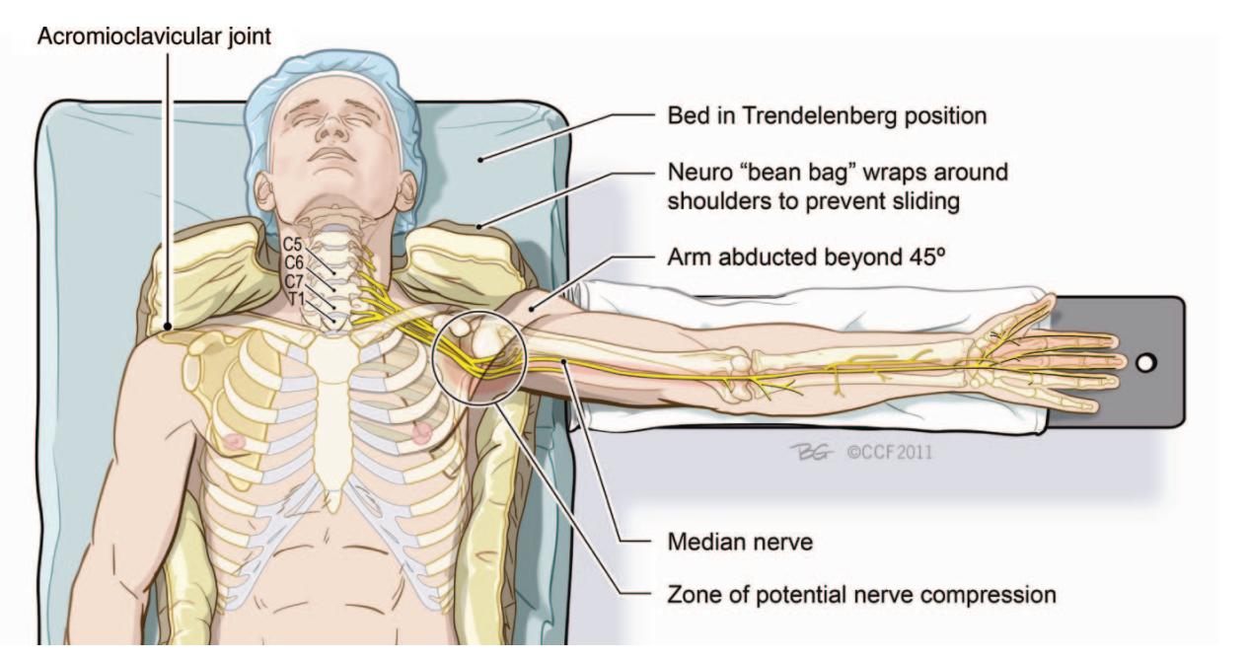

Slide 38
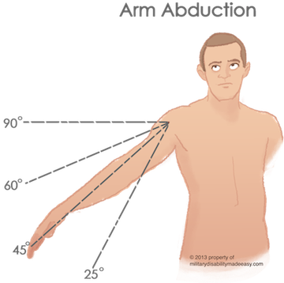
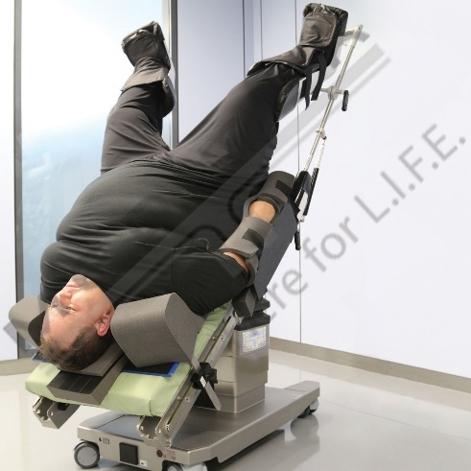
Limit arm abduction in a supine patient to 90°
Avoidance of contralateral neck rotation/flexion
Trendelenburg position
Shoulder padding should distribute pressure evenly across the widest possible area to avoid plexus impingement

Slide 39
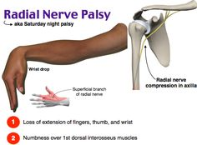
Radial nerve injury (C5–T1)
Mechanism of injury
Compression
Tourniquets/arterial pressure cuffs
Clinical presentation
Wrist drop
Numbness along the posterior surface of the lower part of the arm

Slide 40
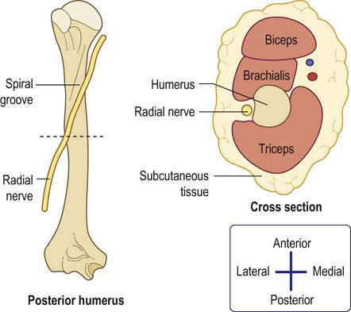
Avoid prolonged pressure on the radial nerve in the spiral groove of the humerus

Slide 41
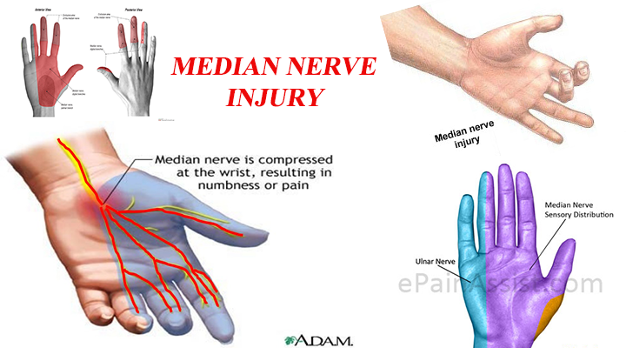
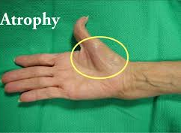
Median nerve injury (C5–T1)
Mechanism of injury
Direct nerve damage from regional techniques
Invasive procedures around the elbow
Compression in the carpal tunnel
Clinical presentation
Paresthesia along the palmar aspect of the lateral three-and-a-half fingers
Weakness of abduction and opposition of the thumb
Thenar eminence become wasted

Slide 42
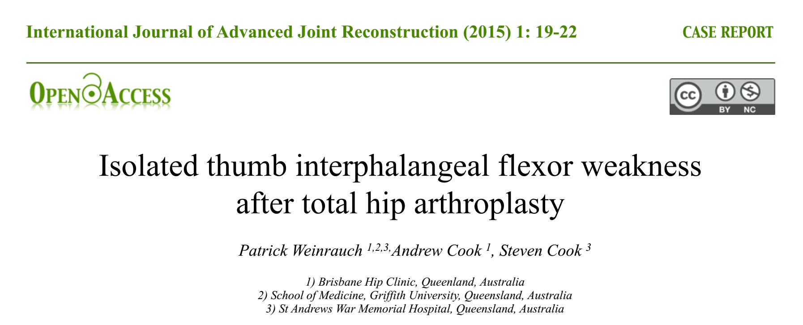
Median neuropathy occurring when patient elbows were fully extended

Slide 43
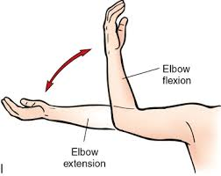
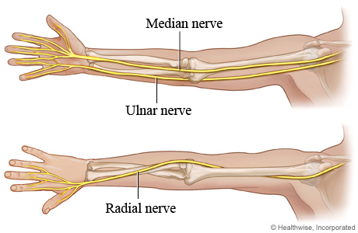
Avoid extension of the elbow beyond the range that is comfortable during the preoperative assessment to prevent stretching of the median nerve

Slide 44
Axillary (C5, 6) and musculocutaneous nerve injury (C5–7)
Mechanism of injury
Shoulder surgery or shoulder dislocations
Clinical presentation
Weakness of shoulder abduction
Anesthesia along the upper lateral border of the arm

Slide 45
Lower limb peripheral nerve injuries
Sciatic nerve injury (L4–S3)
Femoral nerve injury (L2–4)
Peroneal nerve injury (L4–5 S1–2)

Slide 46
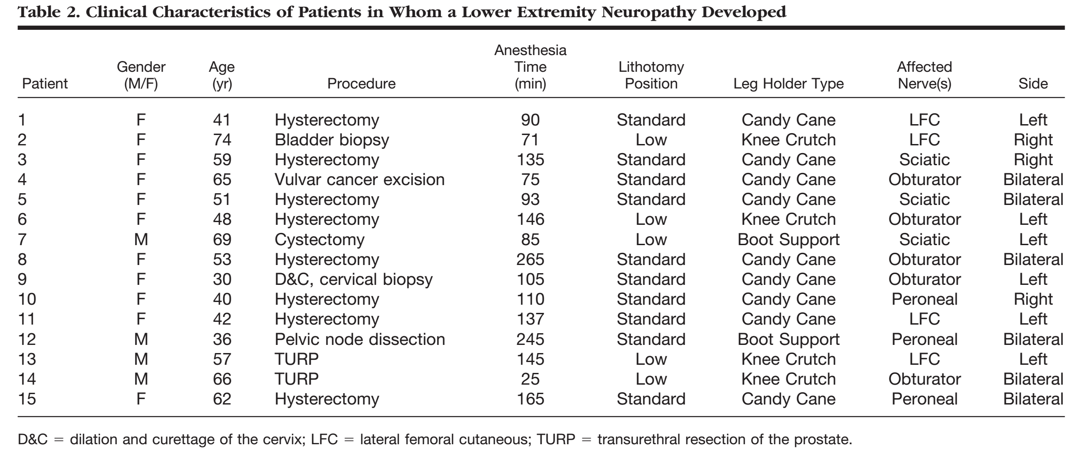

Slide 47
Sciatic nerve injury (L4–S3)
Mechanism of injury
Stretch, compression, ischemia, and direct damage
Lithotomy, frog leg and sitting positions
Clinical presentation
Paralysis of the hamstring muscles
All the muscles below the knee leading to weak knee flexion
Foot drop

Slide 48
Sciatic nerve injury (L4–S3)

Slide 49
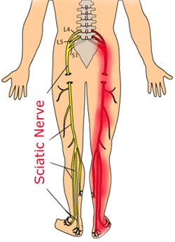
Stretching of the Hamstring Muscle Group
Positions that stretch the hamstring muscle group beyond the range that is comfortable during the preoperative assessment may be avoided to prevent stretching of the sciatic nerve
Limiting Hip Flexion
Sciatic nerve or its branches cross both the hip and the knee joints,

Slide 50
Femoral nerve injury (L2–4)
Mechanism of injury
Compression at the pelvic brim by retractors
Ischemia associated with aortic cross-clamp
lithotomy position with extreme abduction of the thighs and external rotation of the hips
Clinical presentation
Loss of sensation at the front of the thigh and medial aspect of the leg (saphenous nerve)
Weak hip flexion
Decreased or absent knee jerk reflexes

Slide 51
Femoral nerve injury (L2–4)

Slide 52
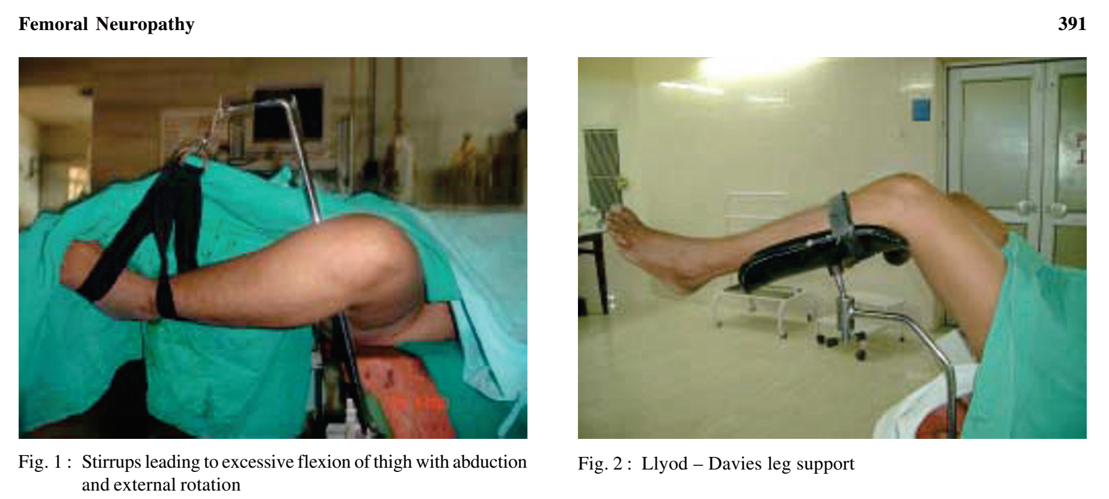
Four case reports describe femoral neuropathy occurring in patients with excessive hip or thigh abduction in the lithotomy body position

Slide 53
Avoid extension or ﬂexion of the hip to decrease the risk of femoral neuropathy

Slide 54
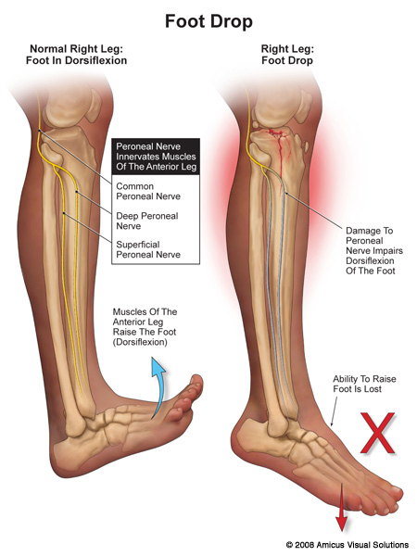
peroneal nerve injury (L4–5 S1–2)
Mechanism of injury
Compression at the fibular head
Lithotomy and the lateral position are the common risk
Clinical presentation
Loss of dorsiflexion and eversion of the foot (equinovarus deformity)
Loss sensation along the anterolateral border of the leg and the dorsum of the digits

Slide 55
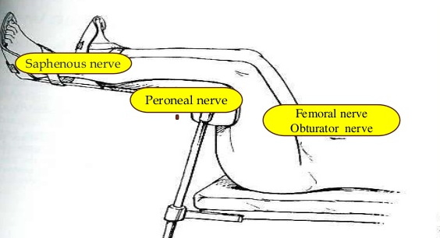
peroneal nerve injury (L4–5 S1–2)
Prevention
Provide position respites for the patient’s legs (e.g. 15 min every 3 h or sooner)
Check that leg supports are not excessively compressing the calves
Ensure that the site at which the common peroneal nerve is most vulnerable (around the head of the fibula) is free from external pressure

Slide 56
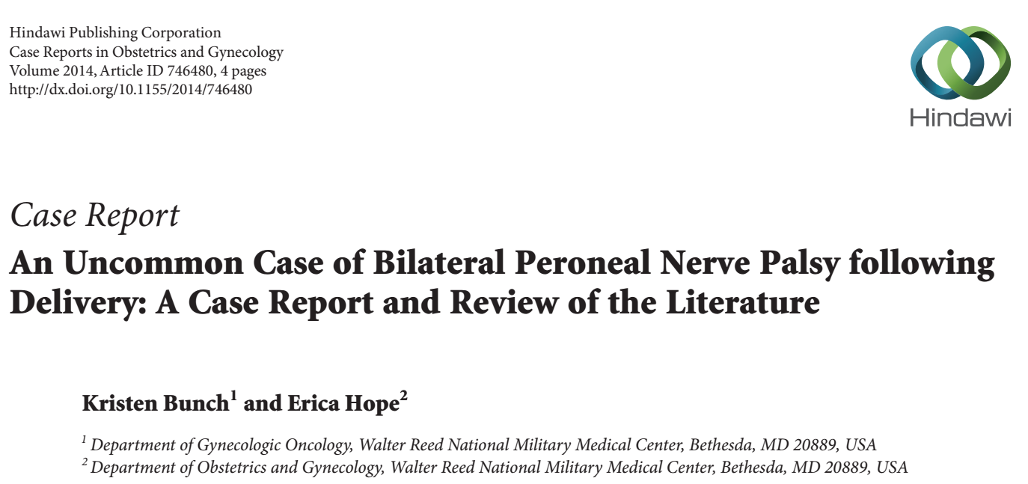

Slide 57
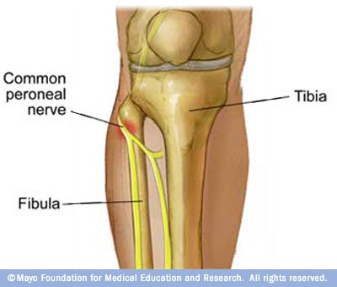
Avoid prolonged pressure on the peroneal nerve at the fibular head

Slide 58
Peripheral nerve injury related to peripheral nerve blockade

Slide 59
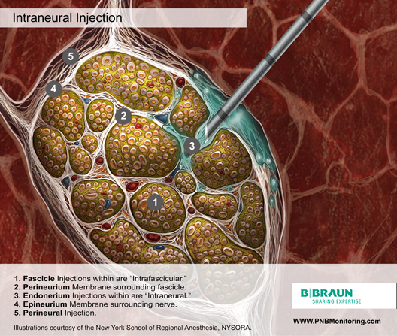
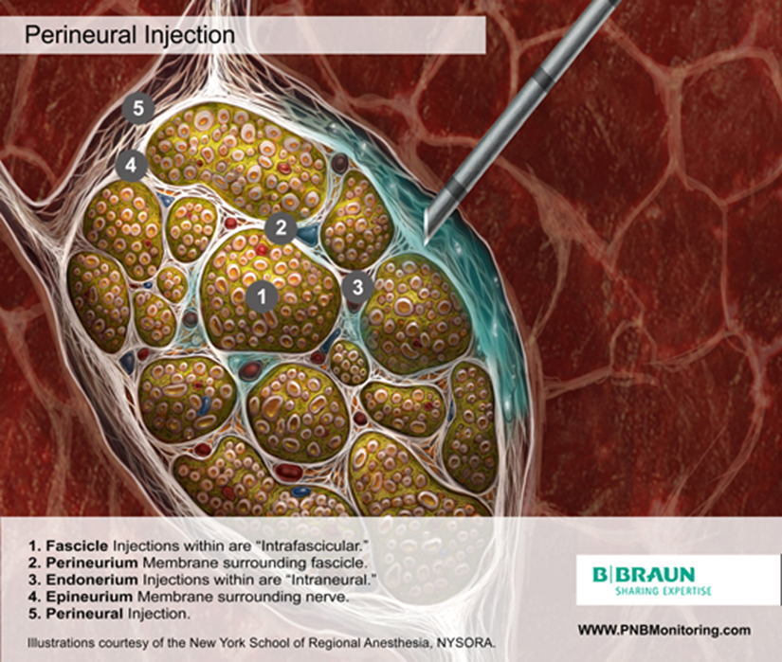

Slide 60
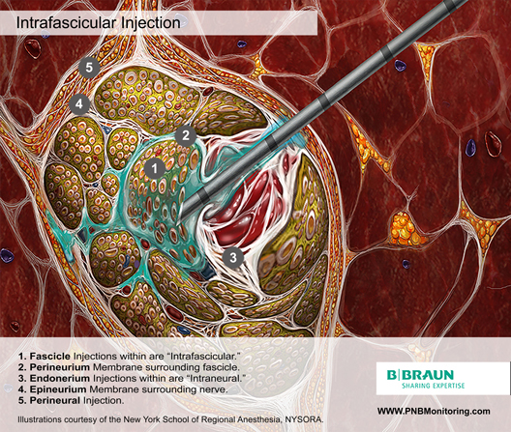
mechanism
Neuronal compression by intraneural injection
Intrafascicular > extrafascicular injection
Local anaesthetic-induced toxicity
Direct mechanical damage
Avoid intraneural injection

Slide 61
Toxicity of local anesthetic and additives
All local anesthetics are potentially neurotoxic
Mechanism remain unclear
Increases in intracellular calcium concentration
Disturbance in mitochondrial function
Interference with membrane phospholipids
Cell apoptosis
Perineurium and blood vessel endothelium serve as a barrier to entry into the fascicle
Local anesthetics placed within the epineurium :
perineural permeability and fascicular edema
Compression of the fascicle and reduced neural blood flow
Effected : dose dependent

Slide 62
Toxicity of local anesthetic and additives
One study comparing extraneural , extrafascicular and intrafascicular administration of ropivacaine showed histologic damage : intrafascicular > extrafasicular> extraneural
Injected inside the epineurium no adverse effect on functional recovery
Ester LA show in some study cause a greater degree injury than amide group
Lidocaine 2% reduce neural blood flow in rat sciatic nerve 20-40%
Increasing concentration lidocaine reduce neural blood flow and reverse in bupivacaine
Epinephrine 5mcg/ml, 10 mcg/ml reduces neural blood flw by 20%-35% but in lower concentration (2.5mcg/ml) neural blood flow transient increases 20% before returning to baseline

Slide 63
Nerve localization methods
No nerve localization technique during needling has been demonstrated scientifically to be superior in terms of reducing the risk of nerve injury following peripheral nerve blockade
Ultrasound guidance
Nerve stimulation
Paresthesia

Slide 64
Peripheral nerve stimulation has a 75% chance to detect needle-to-nerve contact confirmed on ultrasonography
Paraesthesia elicited by needle advancement has only a 38% chance of detecting needle-to-nerve contact

Slide 65
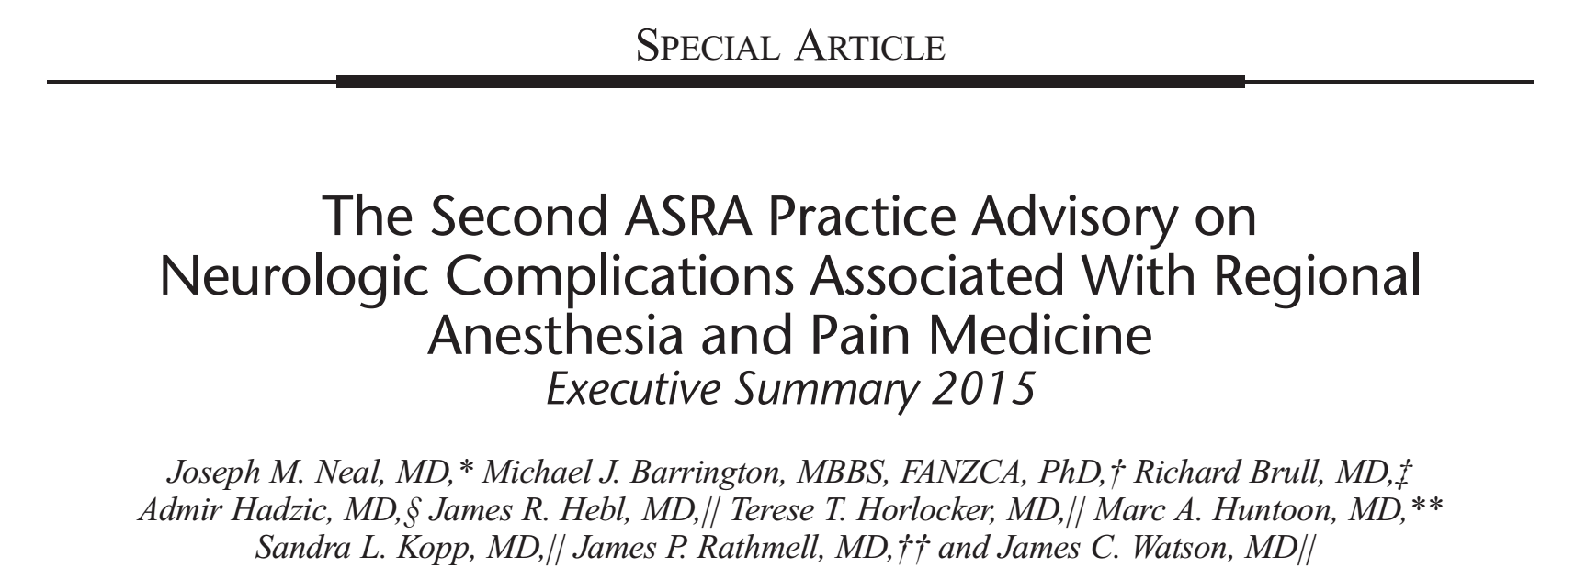

Slide 66
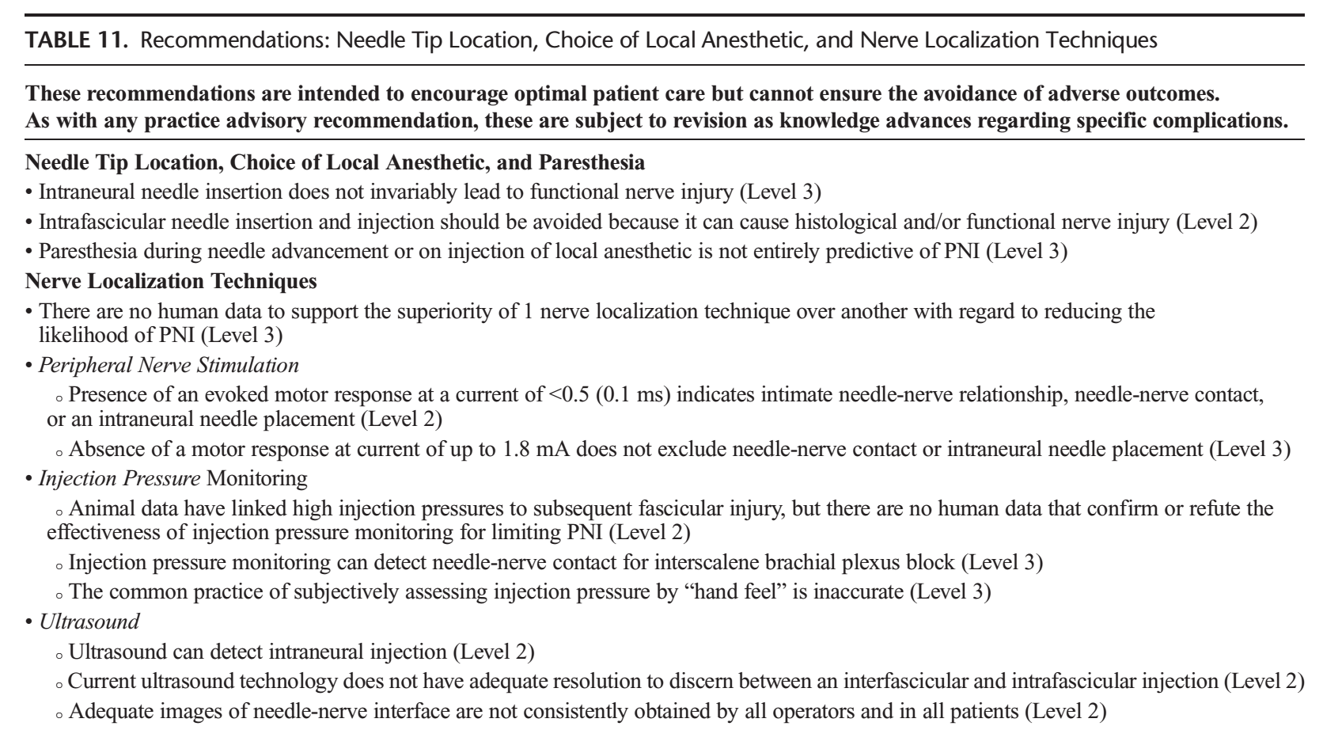
Notes:
> 20 psi -> intrafasicular injection

Slide 67
Notes:
> 20 psi -> intrafasicular injection

Slide 68
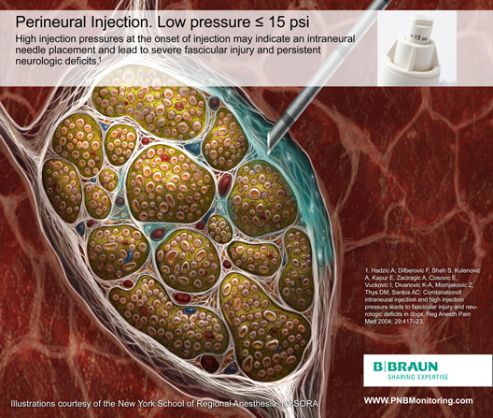
Notes:
> 20 psi -> intrafasicular injection

Slide 69
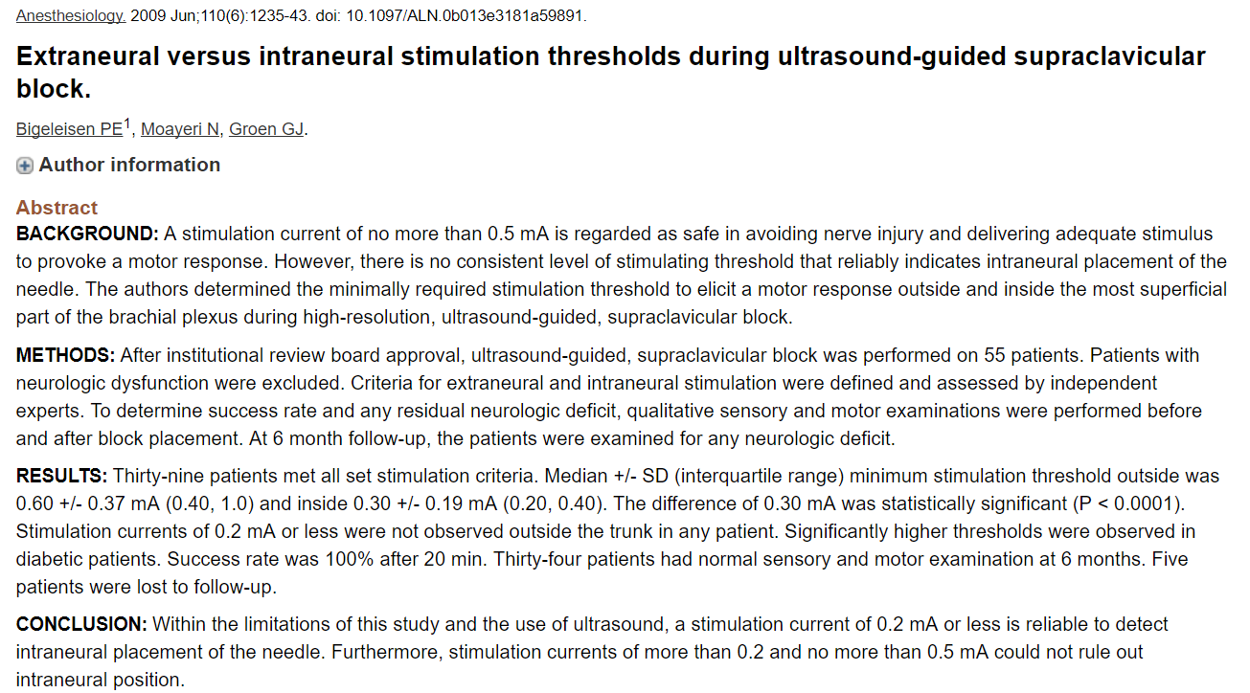
Motor response currents of 0.2 mA or less reliably indicating intraneural placement of the needle

Slide 70
Take home message Peripheral nerve injury
Aware Peripheral nerve injury
Most common -> Ulnar neuropathy , Lithotomy position
Hx + PE , risk factor PNI -> optimize + document baseline
PNI occur
Evaluate /Workup /Diagnosis
Communicate / Consult
Treat reversible cause
Reassure

